Slide 1
CCNA 7.0

Slide 2
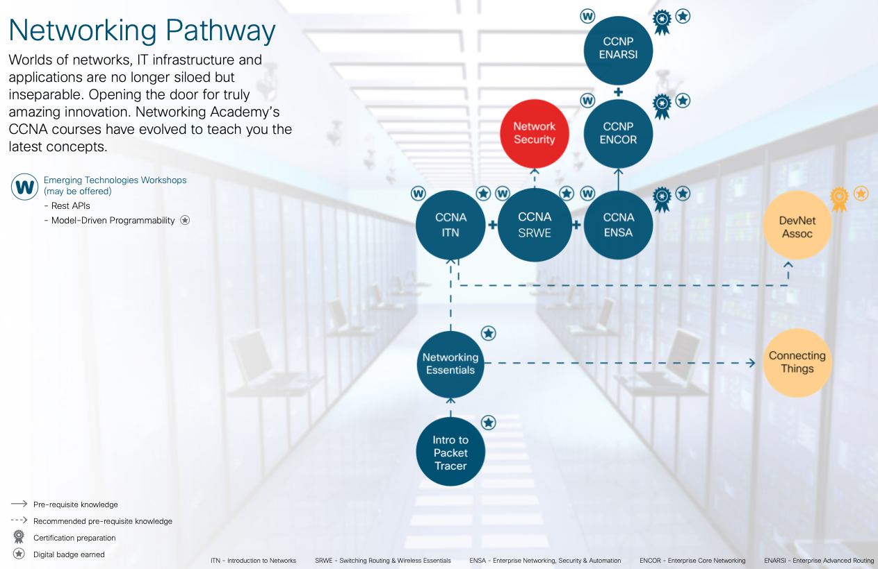

Slide 3
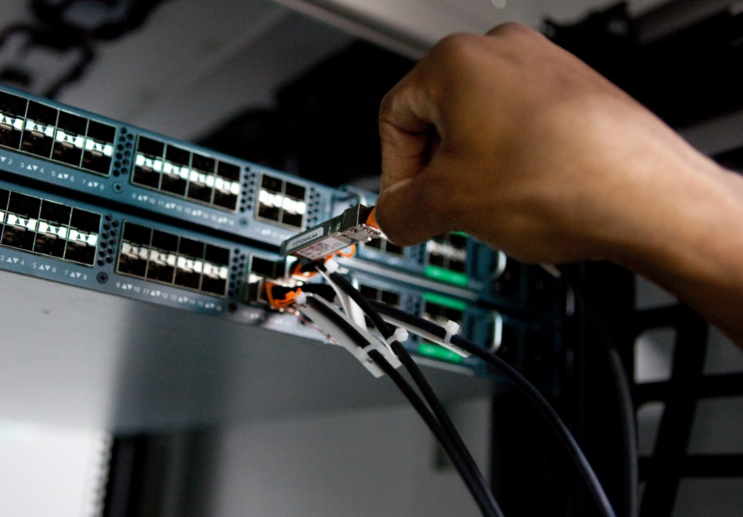

CCNA: Introduction to Networks
Course Overview
The first course in the CCNA curriculum introduces the architectures, models, protocols, and networking elements that connect users, devices, applications and data through the Internet and across modern computer networks - including IP addressing and Ethernet fundamentals.
Benefits
By the end of the course, students can build simple local area networks (LAN) that integrate IP addressing schemes, foundational network security, and perform basic configurations for routers and switches.
Features
Target Audience: Secondary vocational students, 2-year and 4-year college students in Networking or Engineering
Prerequisites: None
Instructor Training Required: Yes
Languages: English
Course Delivery: Instructor-led
Course Recognitions: Certificate of Completion, Letter of Merit, Digital Badge
Estimated Time to Complete: 70 hours
Recommended Next Course: CCNA: Switching, Routing, and Wireless Essentials
Learning Components
17 modules
24 hands-on labs
31 Cisco Packet Tracer activities
36 videos
10 syntax checkers
13 interactive activities
64 CYU quizzes
17 module exams
6 module group exams
1 final exam

Slide 4

Accelerated Path to Job Readiness
Module |  | Module Group Assessments
Module 1 | Networking Today | Basic Network Connectivity and Communications
Module 2 | Basic Switch and End Device Configuration
Module 3 | Protocol Models
Module 4 | Physical Layer | Ethernet Concepts
Module 5 | Number Systems
Module 6 | Data Link Layer
Module 7 | Ethernet Switching
Module 8 | Network Layer | Communicating Between Networks
Module 9 | Address Resolution
Module 10 | Basic Router Configuration
Module 11 | IPv4 Addressing | IP Addressing
Module 12 | IPv6 Addressing
Module 13 | ICMP
Module 14 | Transport Layer | Network Application Communications
Module 15 | Application Layer
Module 16 | Network Security Fundamentals | Building and Securing a Small Network
Module 17 | Build a Small Network
Module
Objectives
Introduction to Networks (ITN)

Slide 5
CCNA: Switching, Routing, and Wireless Essentials
Course Overview
The second course in the CCNA curriculum focuses on switching technologies and router operations that support small-to-medium business networks and includes wireless local area networks (WLAN) and security concepts.
Benefits
Students learn key switching and routing concepts. They can perform basic network configuration and troubleshooting, identify and mitigate LAN security threats, and configure and secure a basic WLAN.
Features
Target Audience: Secondary vocational students, 2-year and 4-year college students in Networking or Engineering
Prerequisites: None
Instructor Training Required: Yes
Languages: English
Course Delivery: Instructor-led
Course Recognitions: Certificate of Completion, Letter of Merit, Digital Badge
Estimated Time to Complete: 70 hours
Recommended Next Course: CCNA: Enterprise Networking, Security, and Automation
Learning Components
16 modules
14 hands-on labs
31 Cisco Packet Tracer activities
15 videos
19 syntax checkers
1 interactive activity
36 CYU quizzes
16 module exams
5 module group exams
1 final exam

Slide 6
Accelerated Path to Job Readiness
Module |  | Module Group Assessments
Module 1 | Basic Device Configuration | Switching Concepts and VLANS
Module 2 | Switching Concepts
Module 3 | VLANs
Module 4 | Inter-VLAN Routing
Module 5 | STP | Redundant Networks
Module 6 | Etherchannel
Module 7 | DHCPv4 | Available and Reliable Networks
Module 8 | SLAAC and DHCPv6 Concepts
Module 9 | FHRP Concepts
Module 10 | LAN Security Concepts | L2 Security and WLANs
Module 11 | Switch Security Configuration
Module 12 | WLAN Concepts
Module 13 | WLAN Configuration
Module 14 | Routing Concepts | Routing Concepts and Configuration
Module 15 | IP Static Routing
Module 16 | Troubleshoot Static and Default Routes
Module
Objectives
Switching, Routing, and Wireless Essentials (SRWE)

Slide 7
CCNA: Enterprise Networking, Security, and Automation
Course Overview
The third CCNA course describes the architectures and considerations
related to designing, securing, operating, and troubleshooting enterprise networks – including wide area network (WAN) technologies & quality of service (QoS) mechanisms for secure remote access, along with software-defined networking, virtualization, & automation concepts supporting network digitization.
Benefits
Students gain skills to configure and troubleshoot enterprise networks,
and learn to identify and protect against cybersecurity threats. They are introduced to network management tools and learn key concepts of software-defined networking, including controller-based architectures and how
application programming interfaces (APIs) enable network automation.
Features
Target Audience: 2-year and 4-year college students in Networking or Engineering
Prerequisites: None
Instructor Training Required: Yes
Languages: English
Course Delivery: Instructor-led
Course Recognitions: Certificate of Completion, Letter of Merit, Digital Badge
Estimated Time to Complete: 70 hours
Recommended Next Course: CCNP Enterprise Core
Learning Components
14 modules
12 hands-on labs
29 Cisco Packet Tracer activities
32 videos
13 syntax checkers
2 interactive activities
53 CYU quizzes
14 module exams
5 module group exams
1 final exam
1 practice exam for CCNA certification exam

Slide 8
Accelerated Path to Job Readiness
Module |  | Module Group Assessments
Module 1 | Single-Area OSPFv2 Concepts | OSPF Concepts and Configuration
Module 2 | Single-Area OSPFv2 Configuration
Module 3 | Network Security Concepts | Network Security
Module 4 | ACLs Concepts
Module 5 | ACLS for IPv4 Configuration
Module 6 | NAT for IPv4
Module 7 | WAN Concepts | WAN
Module 8 | VPN and IPsec Concepts
Module 9 | QoS Concepts | Optimize, Monitor, and Troubleshoot Networks
Module 10 | Network Management
Module 11 | Network Design
Module 12 | Network Troubleshooting
Module 13 | Network Virtualization | Network Virtualization and Automation
Module 14 | Network Automation
Module
Objectives
Enterprise Networking, Security, and Automation (ENSA)

Slide 9
Web and Email Protocols
Email Protocols
Email is a store-and-forward method of sending, storing, and retrieving electronic messages across a network. Email messages are stored in databases on mail servers. Email clients communicate with mail servers to send and receive email.
The email protocols used for operation are:
    Simple Mail Transfer Protocol (SMTP) – used to send mail.
    Post Office Protocol (POP) & IMAP – used for clients to receive mail.
Notes:
15 – Application Layer
15.3 – Web and Email Protocols
15.3.3 – Email Protocols

Slide 10
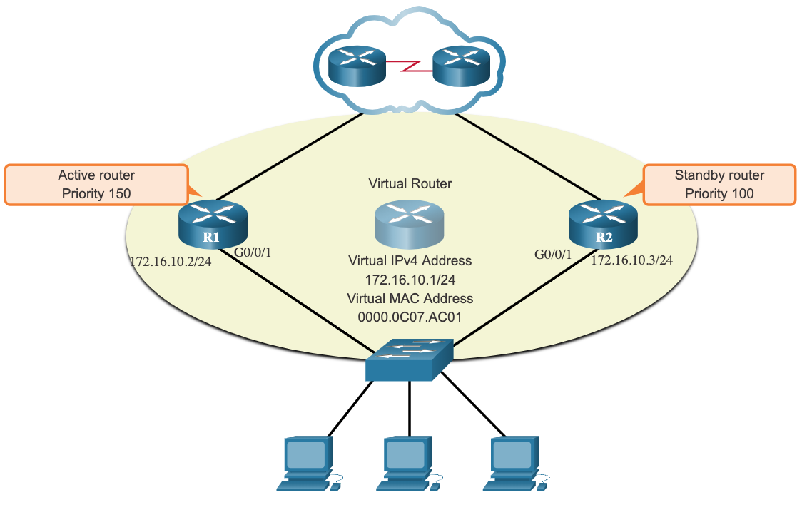
HSRP
HSRP Priority and Preemption (Cont.)
By default, after a router becomes the active router, it will remain the active router even if another router comes online with a higher HSRP priority.
To force a new HSRP election process to take place when a higher priority router comes online, preemption must be enabled using the standby preempt interface command. Preemption is the ability of an HSRP router to trigger the re-election process. With preemption enabled, a router that comes online with a higher HSRP priority will assume the role of the active router.
Preemption only allows a router to become the active router if it has a higher priority. A router enabled for preemption, with equal priority but a higher IPv4 address will not preempt an active router. Refer to the topology in the figure.
Note: With preemption disabled, the router that boots up first will become the active router if there are no other routers online during the election process.
Notes:
9 – FHRP Concepts
9.2 – HSRP
9.2.2 – HSRP Priority and Preemption (Cont.)

Slide 11
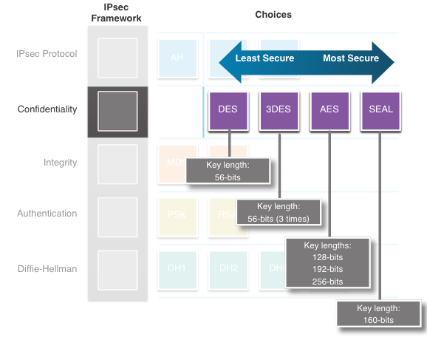
IPSec
Confidentiality (Cont.)
The encryption algorithms highlighted in the figure are all symmetric key cryptosystems:
    DES uses a 56-bit key.
    3DES uses three independent 56-bit encryption keys per 64-bit block.
    AES offers three different key lengths: 128 bits, 192 bits, and 256 bits.
    SEAL is a stream cipher, which means it encrypts data continuously rather than encrypting blocks of data. SEAL uses a 160-bit key.
Notes:
8 – VPN and IPsec Concepts
8.3 – IPsec
8.3.4 – Confidentiality (Cont.)

Slide 12
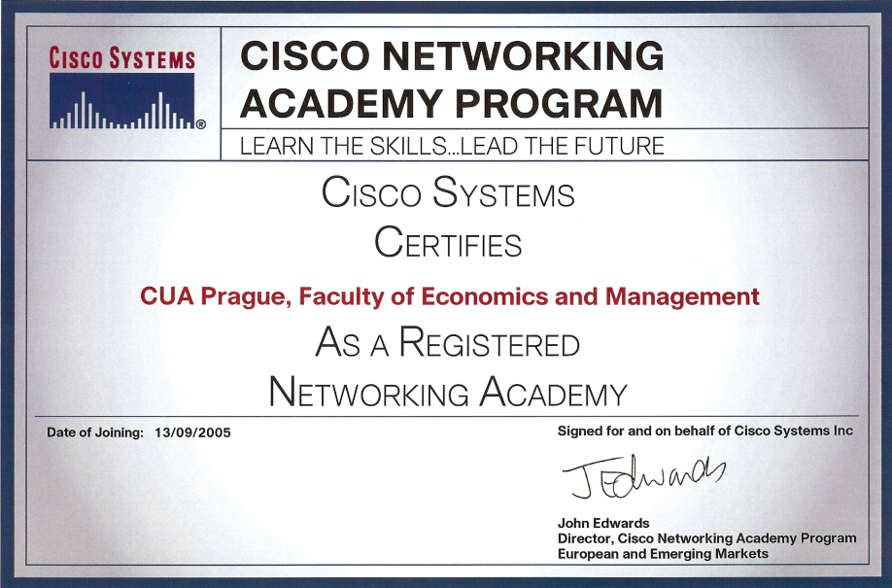
Katedra informačních technologií PEF ČZU v Praze

Slide 13
Katedra informačních technologií PEF ČZU v Praze

Slide 14
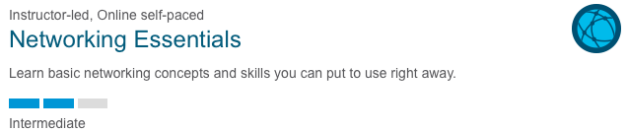
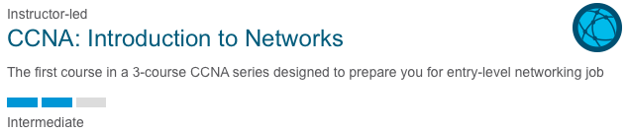
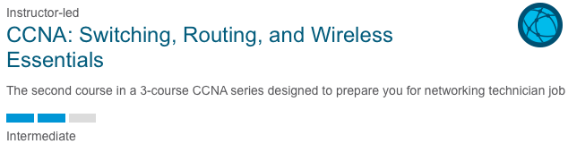
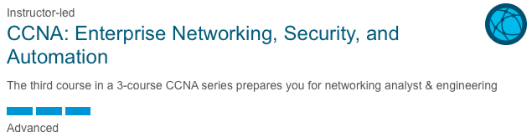
ZS 2025/26
0,- Kč
Self-kurz
ZS 2025/26
3 630,- Kč
LS 2025/26
3 630,- Kč
ZS 2026/27
3 630,- Kč
Kurzy jsou otevřeny při dostatečném počtu studentů.

Slide 15
CCNA: Introduction to Networks
Kurz je určen primárně pro 1. ročník oboru InfoN (začátek v ZS) – prezenční/kombinované studium
Výuka ZS: pondělí 19:15 – specializovaná LVT PEF D326, Packet Tracer, online v MS Teams
v případě velkého počtu zájemců bude otevřen 2. kurz ve středu 19:15, D326 (viz oficiální rozvrh 1. ročník InfoN)
Přihlášky na webu KIT (https://kit.pef.czu.cz/zpravy-akce-prednasky/kurzy-cisco-v-zs-25-26/ ) do 8.10. 2025
Předběžný seznam bude zveřejněn 9. 10. 2025 na přednášce Počítačové sítě (lze zde ještě upřesnit)
Cena kurzu: 3 630,- Kč (cena včetně 1. termínu zkoušky a certifikátu o absolvování)
    dotovaná cena na pokrytí nákladů, po zaplacení storno 100 %
    v i-com-unity z. s. je pro zájemce z neakademické sféry cena jednoho kurzu 26 620,- Kč
Rozhoduje pořadí přihlášky a následně včasná úhrada
V případě dostatečného počtu zájemců o kurz budou následně zaslány údaje pro platbu
Zahájení kurzu: pondělí 20. 10. 2025
Vyučující Ing. Jaromír Holec (Ing. Alexander Vasilenko, Ph.D., Ing. Jan Pinta)

